Slide 1
EDA CASE STUDY SUBMISSION
Group Name:
Akhil Verma
Ambika Mathur
Pranjal Paliwal
Sajal Rastogi

Slide 2
Business Objective
To identify the variables which indicates that a loan taker is defaulter or not and also use these insights in approval/rejection decision making.
Some of the type of loans we have into account are Credit Card , Debt Consolidation , Home Loan.

Slide 3
Data Understanding
Demographic variables – which indicates basic information of a loan taken
Loan information & Loan characteristics
Behavioural variables A few of them are listed below.
Demographics | Loan Characteristics | Behvaioural Variables
Emp_title | Loan amount | Delinq_2years
Emp_length | Funded amount | Revol_bal
Home_ownership | Interest rate | Out_Prncp
Annual_inc | Loan status | Total_pymnt
Verification_status | Loan grade | Recoveries
Addr_state | DTI (Debt to income) | Last_pymnt_amnt
Zip_code | Loan term | Earliest_cr_line
Purpose | Loan issue date | Application_type

Slide 4
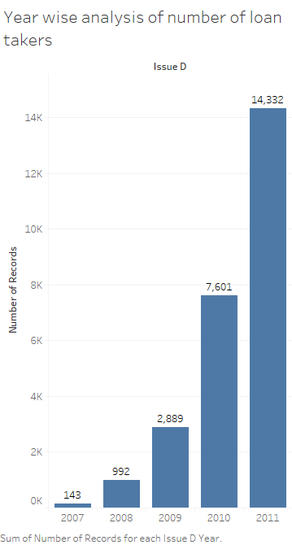
Yearly Analysis of Data
The number of loan applicants are increasing every year at an exponential rate.
Increment in number of loan applicants are approximately double every year , 2009-2011.

Slide 5
Purpose of distribution
46.8% Debt consolidation loans
13% Credit Card
7.5% Home improvement loans
5.6% major purchase loans
Excluding “others” as we are not sure about the background of loan.
Top 3 loans makes 75% of the total purpose , so moving forward we will consider these three (Debt consolidation , Credit card and Home improvement).

Slide 6
Defaulters by Loan Purpose
Small Business is the highest with 27%
Debt consolidation - 15%
Home improvement – 12%
Credit Cards – 11%

Slide 7
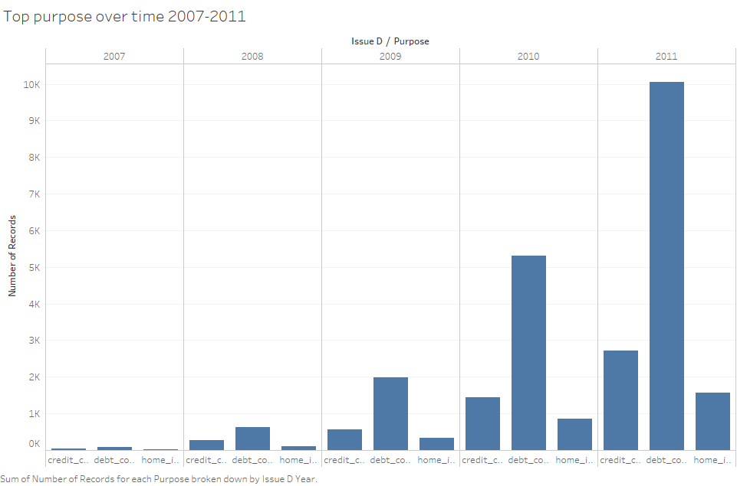
Top Purposes over time 2007-2011
Debt consolidation is Consistently highest among all from 2007-2011 Followed by Credit card and then Home Improvement.

Slide 8
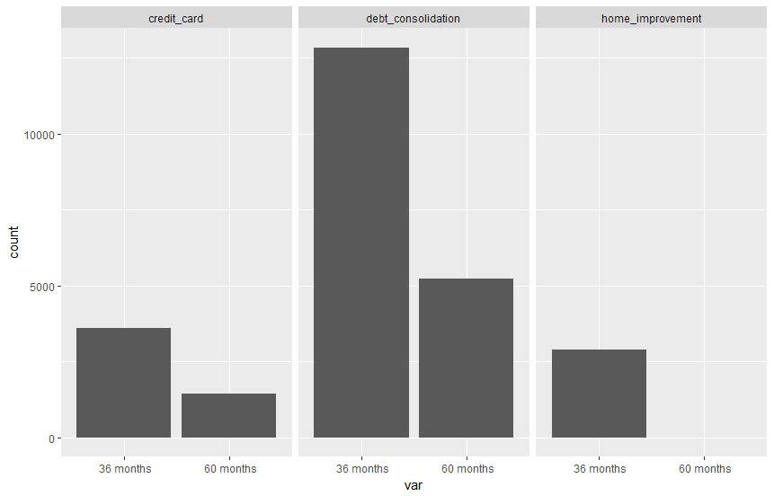
Term Distribution Among top 3 loan purpose
It is clear that 36 months plan is more popular than 60 Months plan.
Also we can see 60month plan is not there in Home improvement. Either the people are not interested in taking 60motn tenure or the Lending company is not interested.

Slide 9
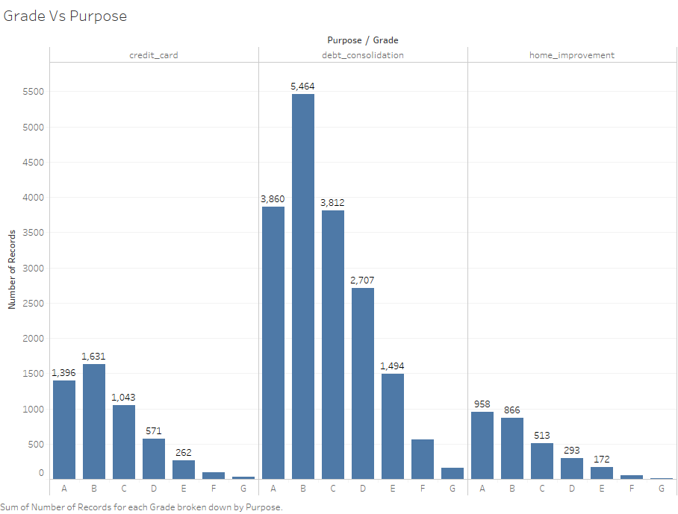
Grade Distribution among Top 3 loans
Most of the loan takers are among Grade A or Grade B.
For Credit Card Grade B is highest.
For Debt Consolidation Grade B is highest.
However for Home Improvement Grade A is highest.

Slide 10
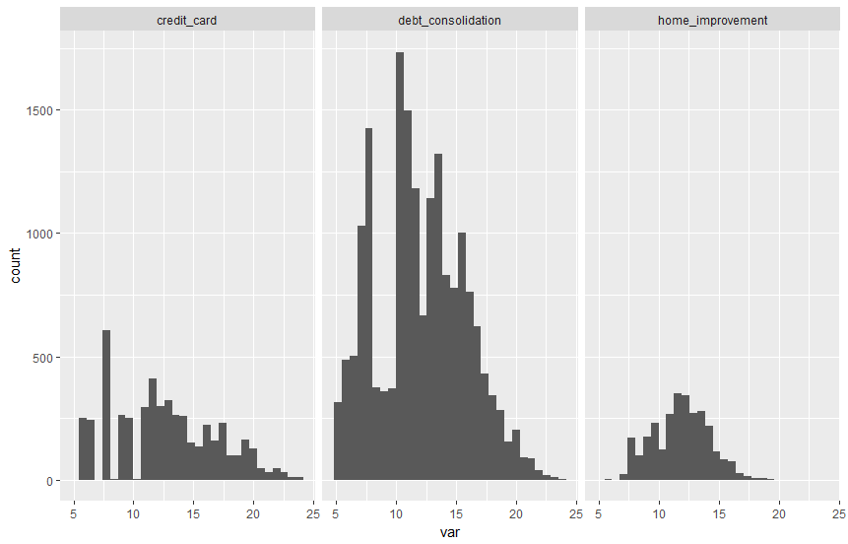

Average Interest Rate Among Loan Purpose
Approx 12.4% for Debt Consolidation
Approx 11.6% for Credit Card
Approx 11.3% for Home Improvement
R Output Screenshot

Slide 11
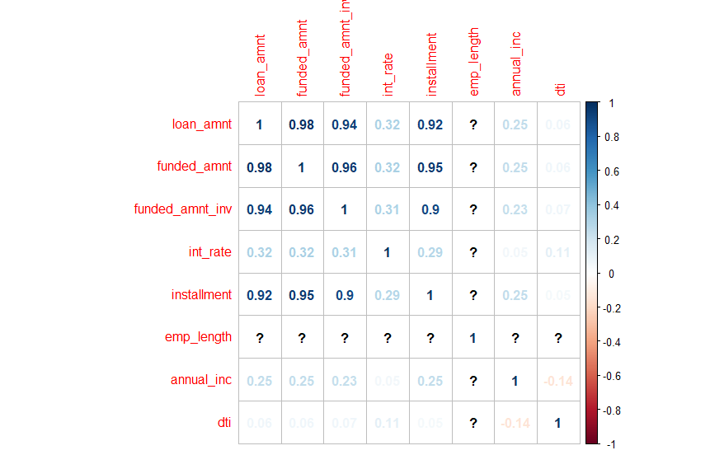
Correlation Among Important Variables

